Slide 1
Deep Pyramid Convolution Neural Networks for Text Categorization
Rie Johnson & Tong Zhang
Presented By: Balwant Singh Bisht

Slide 2
Introduction
Text categorization is the task of assigning predefined categories to free-text documents.
Spam Detection
Sentiment Classification
Topic Classification
Various Approches
Pre- 2014: Bag of Words + Linear Classifiers ( SVM )
After-2014: Move to Deep Learning

Slide 3
Why DPCNN?
Deep Character level CNNs
Pros: Don’t have to deal with millions of distinct words
Cons: Less accurate and very slow than word-level CNNs
Shallow CNN
Short range associations
LSTM
Long range associations but slow
DPCNN
Long range associations and fast

Slide 4

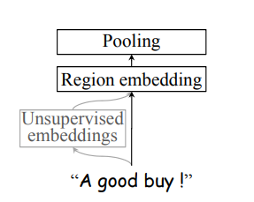
Shallow CNN
Max(avg) Pooling
Region embedding = Convolution
Unsupervised embeddings
One hot encoding

Slide 5
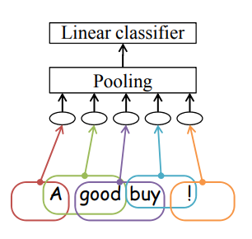
Text Region Embedding: Basic
In each oval, computation in the following form takes place
𝛔(W(x) + b
𝛔 is component wise non-linearity
𝛔(𝑥) = max(0, 𝑥)
Input x is one-hot representation of each text-region(e.g ‘good buy’)

Slide 6
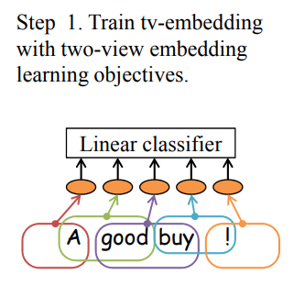
Text Region Embedding: Enhanced with unsupervised
embeddings
Unsupervised embeddings are obtained by tv embeddings
tv stands for two views
Predict adjacent text regions (one view) based on a text region (the other view)

Slide 7
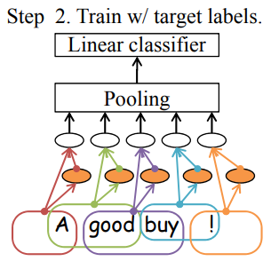

Text Region Embedding: Enhanced with unsupervised
embeddings
tv-embedding is used to produce additional input to the base model and train it with labeled data
Region embedding funtion for multiple tv-embeddings

Slide 8
Shallow CNN

Slide 9
What the region embedding layer of shallow CNN Does?
Captures Short range associations
Captures more complex concepts with single layer, word embedding takes multiple layers
Disadvantage
Small text regions cannot capture long range associations
LSTM addresses the issue but computationally slow

Slide 10
Long Range Associations by LSTM
Linear Classifier
Pooling
Embedding of ‘A good’
Embedding of ‘A good buy’
Embedding of ‘A good buy !’
Embedding of ‘A’
A
good
buy
!
Ouput at each word: embedding of text seen so far
Large region size but sequential computation (thus slow)

Slide 11
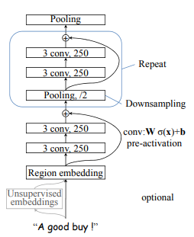
DPCNN Structure
Downsampling with the number of feature maps fixed
Reduces per block computation
Total computation bounded by constant
Shortcut connections with pre activation and identity mapping
Enables training
Text region embedding enhanced with unsupervised embeddings
Improves accuracy

Slide 12
Downsampling with number of feature maps fixed
Max-pooling with size 3 and stride 2
Component wise maximum over 3 contiguous internal vectors
Reduces size of internal representation by half
Computation time for each block is halved

Slide 13
Shortcut connections with pre-activations
Eases training of deep networks
Written as z + f(z) where f represents skipped layers ( two convolution layers with pre-activation)
Pre-activation
Activation is done before weighting W𝞼(x) + b
𝞼(𝑥) = max(𝑥,0)
Linearity eases training (empirically)
No need for dimension matching

Slide 14
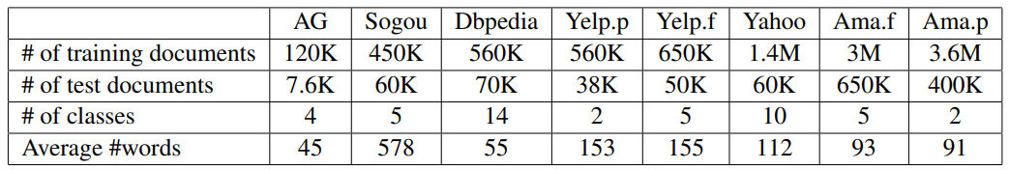
Experiments: Dataset
AG and Sogou are news
Dbpedia is an ontology
Yahoo consists of questions and answers
Yelp and Amazon are reviews: .p represents binary labels, .f represents stars
Vocabulary size: 30K words

Slide 15
Experiments: Training
Minimize log loss with softmax with mini-batch SGD
Weights were initilized by Gaussian distribution with zero mean and standard deviation 0.01
Input to region embedding layer was fixed to BOW input
Output dimensionaly: 250

Slide 16
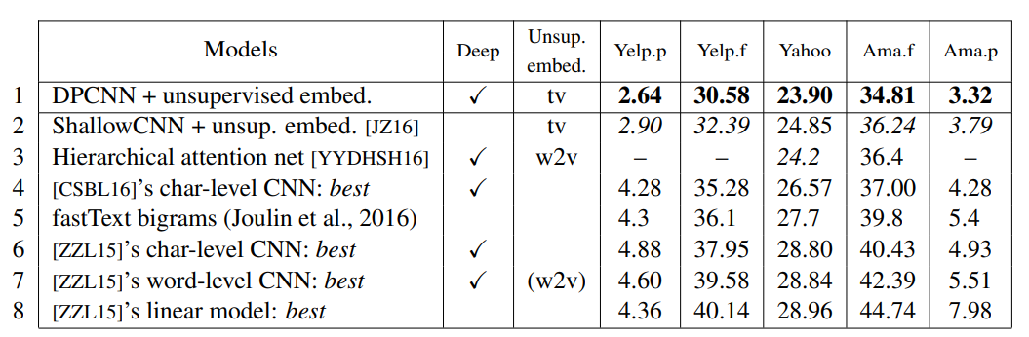
Results: Error rates(%) comparison on Large data
Depth: 15 weight layers plus unsupervised embeddings

Slide 17
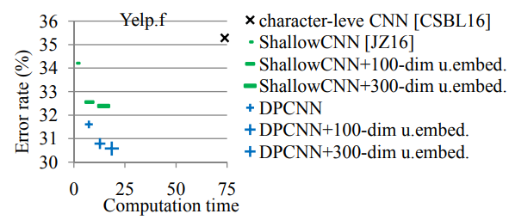
Results: Error rates vs Computation time

Slide 18
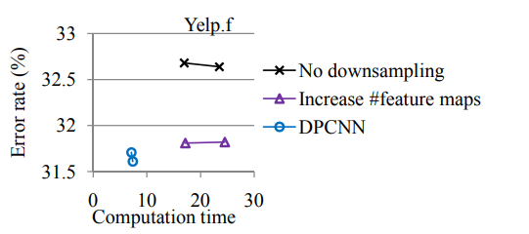
Results: Comparison with non-pyramid models

Slide 19
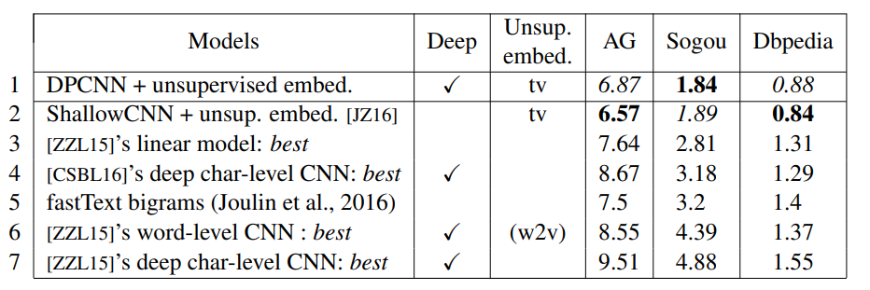
Results: Error rates(%) comparison on smaller data

Slide 20
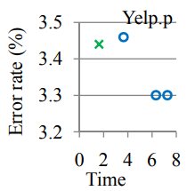
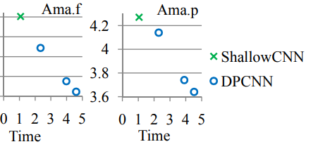
Results: Error rates(%) comparison with depth

Slide 21
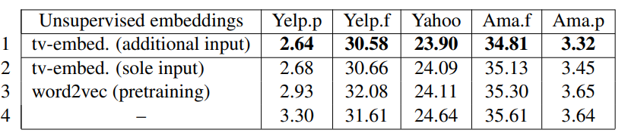
Results: Error rates(%) comparison with variations in
unsupervised embeddings

Slide 22
Conclusion
Problem: To design a high performance deep word-level CNN for text categorization for large training data
Deep pyramid CNN model is proposed with
Low complexity
Efficient long range associations in text
Accuracy better than previous models on six benchmark datasets

Slide 23
Thank You

